Slide 1
Impacts and Riding Ailments on Loco - Pilots
While driving a Locomotive on Indian Tracks and If Seating Arrangements for Loco-Pilots are not proper!

Slide 2
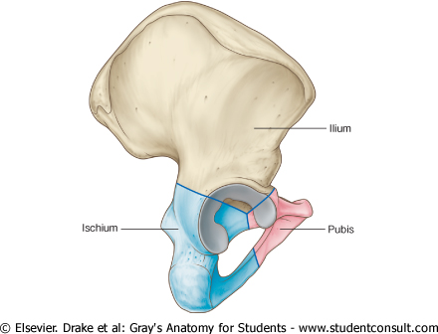
Pelvis A.K.A Hip Bone
IRREGULAR BONE
BONE OF PELVIC GIRDLE
MADE UP OF 3 BONES
ILIUM, PUBIS, ISCHIUM
ALL OF THREE SEPARATED BY
LARGE CAVITY, ACETABULUM
WHICH FORM HIP JOINT WITH
HEAD OF FEMUR
OTHER FEATURES INCLUDE
ILIAC CREST, OBTURATOR FORAMEN,
ISHIAL TUBOROSITY

Slide 3
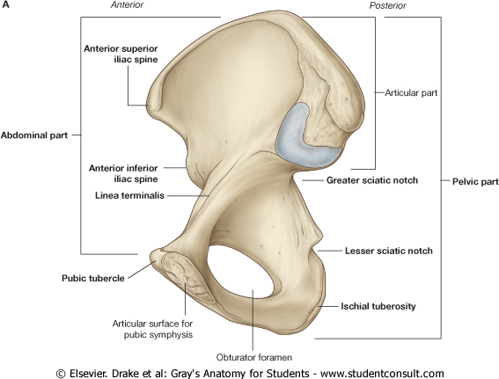
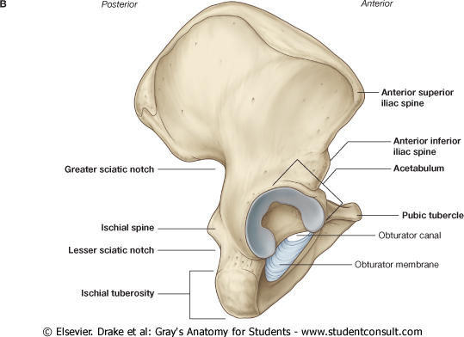

Slide 4
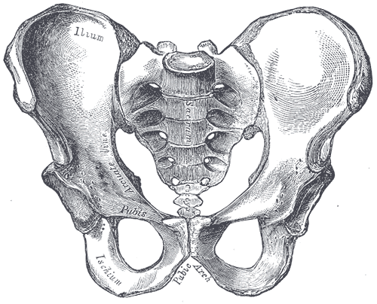
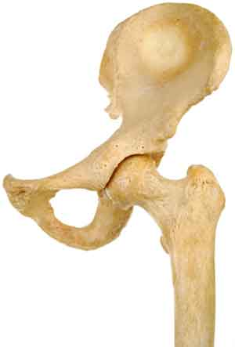
Pelvis A.K.A Hip Bone
SACROILIAC JOINT
WITH SACRUM
HIP JOINT
WITH HEAD OF
FEMUR

Slide 5
Spine
Divided into 5 main regions
Cervical (7)
Thoracic (12)
Lumbar (5)
Sacrum (5)
Coccyx (4)
Total number is 33
but
*note: The 5 sacral vertebrae and 4 coccyx vertebrae fused to form one sacrum and one coccyx bone when at the age of adultery.
Ultimately total number is 26 only

Slide 6
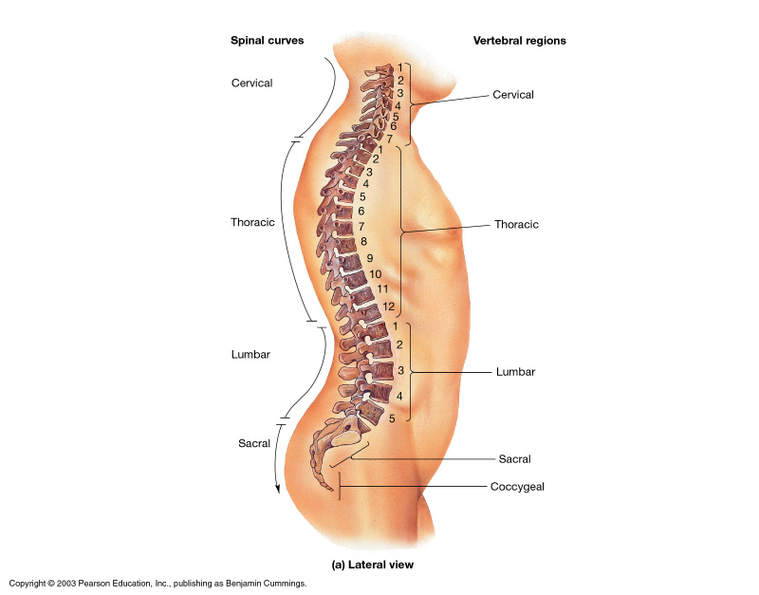
Spine

Slide 7
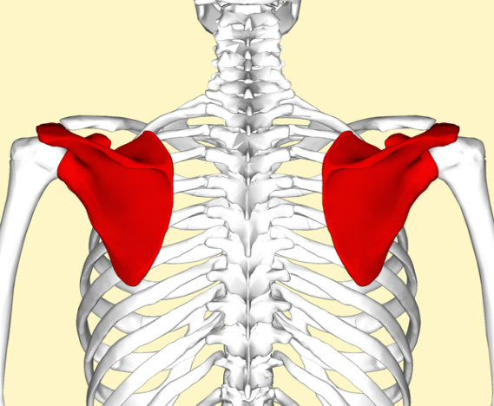
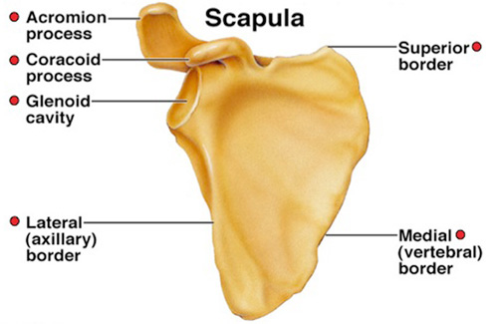
Scapula or Shoulder Girdle
The scapula is a flat triangular bone
Lies on the posterior chest wall
Consist of 3 borders, 3 surfaces, 3 angles
In its posterior surface the spine of the scapula projects backward
Glenoid cavity is a shallow cavity which articulate with head of humerus to form shoulder joint.
The coracoid process and acromion process projects upward and forward above the glenoid cavity
The anterior surface of the scapula is concave & form the shallow subscapular fossa

Slide 8
Signs and Symptoms
Basic and common:
Back Pain
Muscle Ache
Numbness
Tiredness or Fatigue

Slide 9
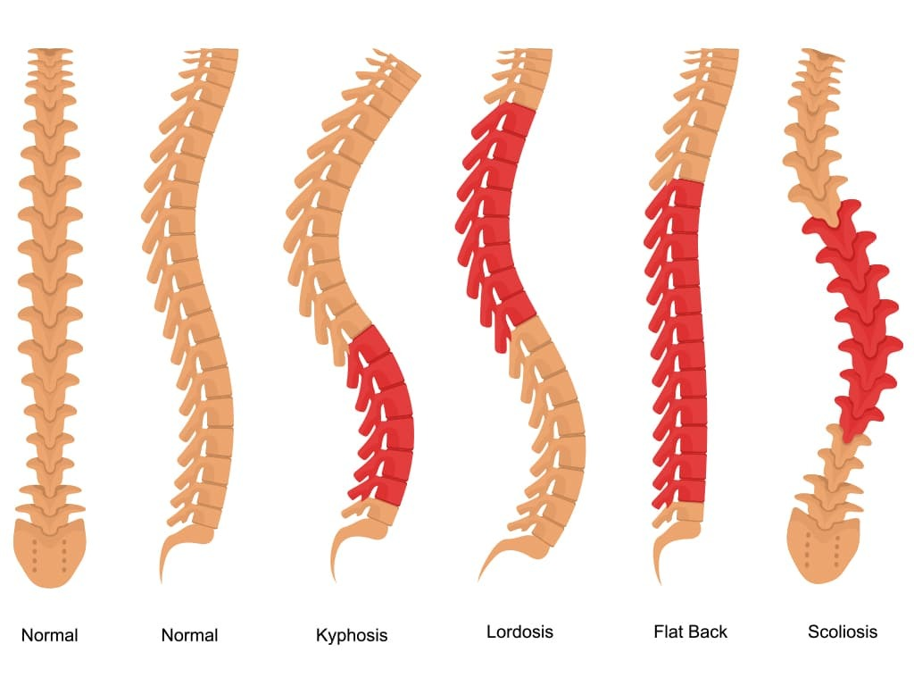
Signs and Symptoms
Chronic Issues:
Misalignment
Minute Kyphosis
Minor Lordosis
Minor Scoliosis
Slip disc
Arthritis (on patella/Knee region)

Slide 10
Be healthy than being wealthy! Thank you!

